Slide 1
Kimai

Slide 2
Functionalities
Runs a time counter in the background ? Maybe useful but kinda redundant
Is Mobile ready
Supports Plugins ? Unclear
Teams creation
Customers data
Projects data
Activities
User profile
Export to excel, pdf, csv and html
Expenses
SAML – Security something
LDAP – Security something
Statistics
Duration only
Adjustable rates – workday, weekends
Customizable permissions

Slide 3
Installation via docker
Check how this is done

Slide 4
1. To check: data objects
Scenarios:
Data updating and creation:
Teams creation
Customers data
Projects data
Activities
Users ?
Expenses and rates. Do we want/need this ?
can we obfuscate the data for the developers ?

Slide 5
2. To check: Security and permissions
SAML – Security something
LDAP – Security something
permission setup

Slide 6
3. To check: statistics
What metrics are included
How do they add new ones ?

Slide 7
4. To check: exporting
What are they exporting
What format are they exporting to ?

Slide 8
Generic
Is there a way to freeze accounts after exporting them ?
Maybe german law duration rules should also be applied – breaks and max per day/week.
no quick filters
Seems like a lot of information is redundant: reports, mytimes, calendar, kinda show the same info for a user: the dates, activities and hours per day
Dashboard shows just another view of reports but restricted to 1 week
Feiertage in Kalendar

Slide 9
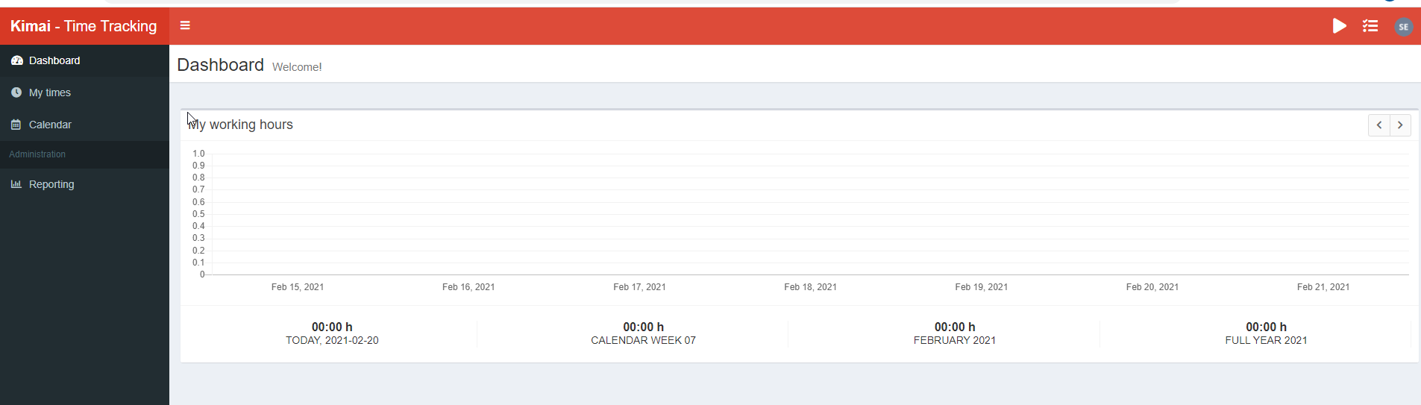
UI overview

Slide 10
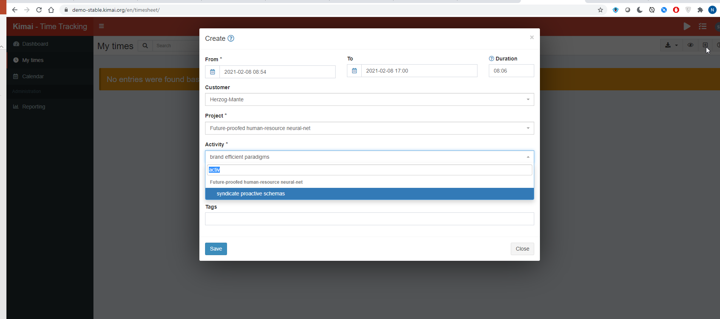
Activities
Seems activities require pre-saved activities
Basically activty would be an equiv to issue or workpackage

Slide 11
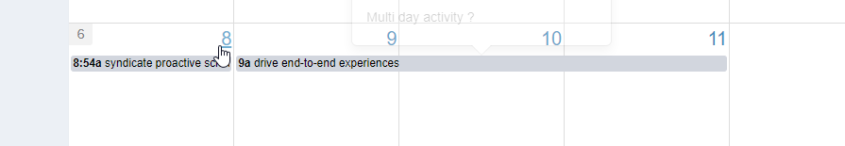
Multiday activity recorded
Not sure if this is good or bad .
Calendar page does not provide an overview of duration and minus or plus.
Caklendar allows drag and drop but no ctrl-click duplication or copy

Slide 12
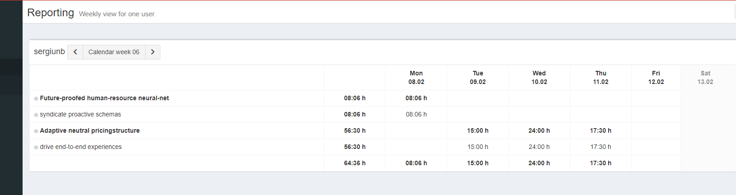
Reports
- weird report on the multiday activity –something bad on my side ?

Slide 13
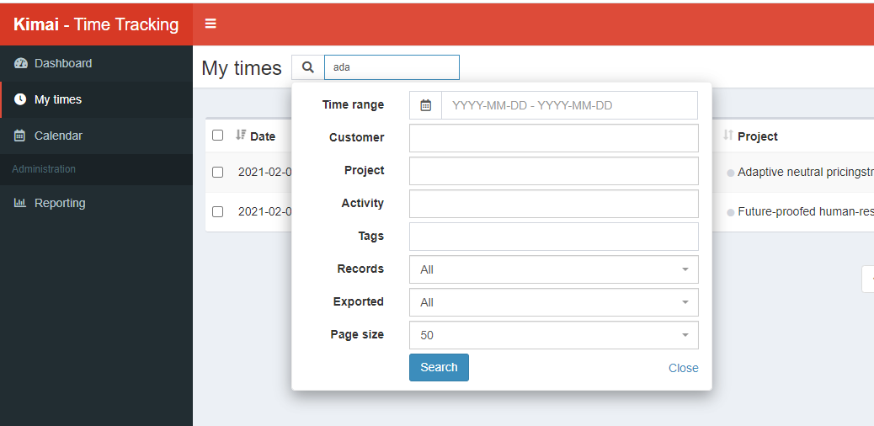
My times ?
- No quick search on columns OR global

Slide 14
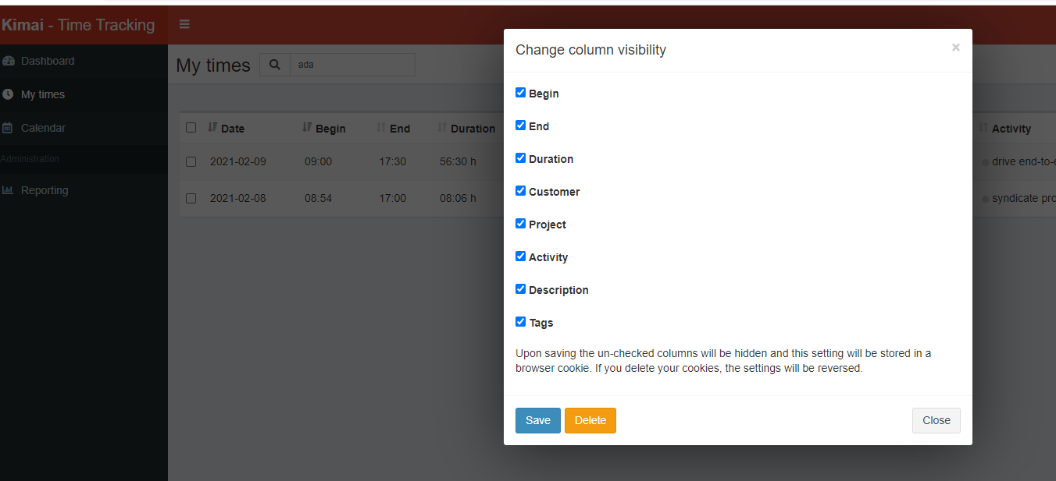
Add or remove displayed columns

Slide 15
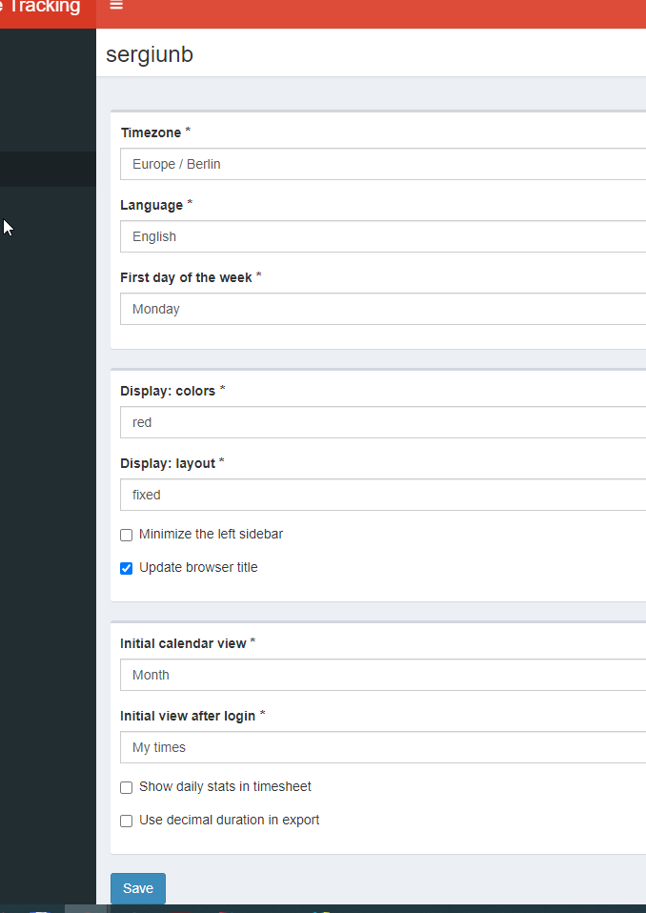
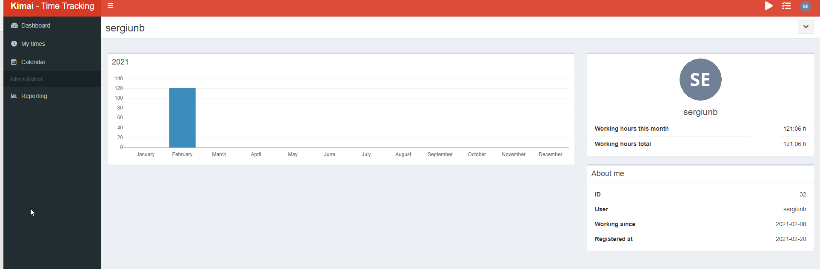
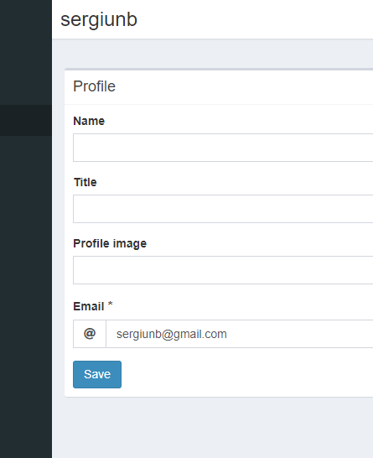
My profile:

Slide 16
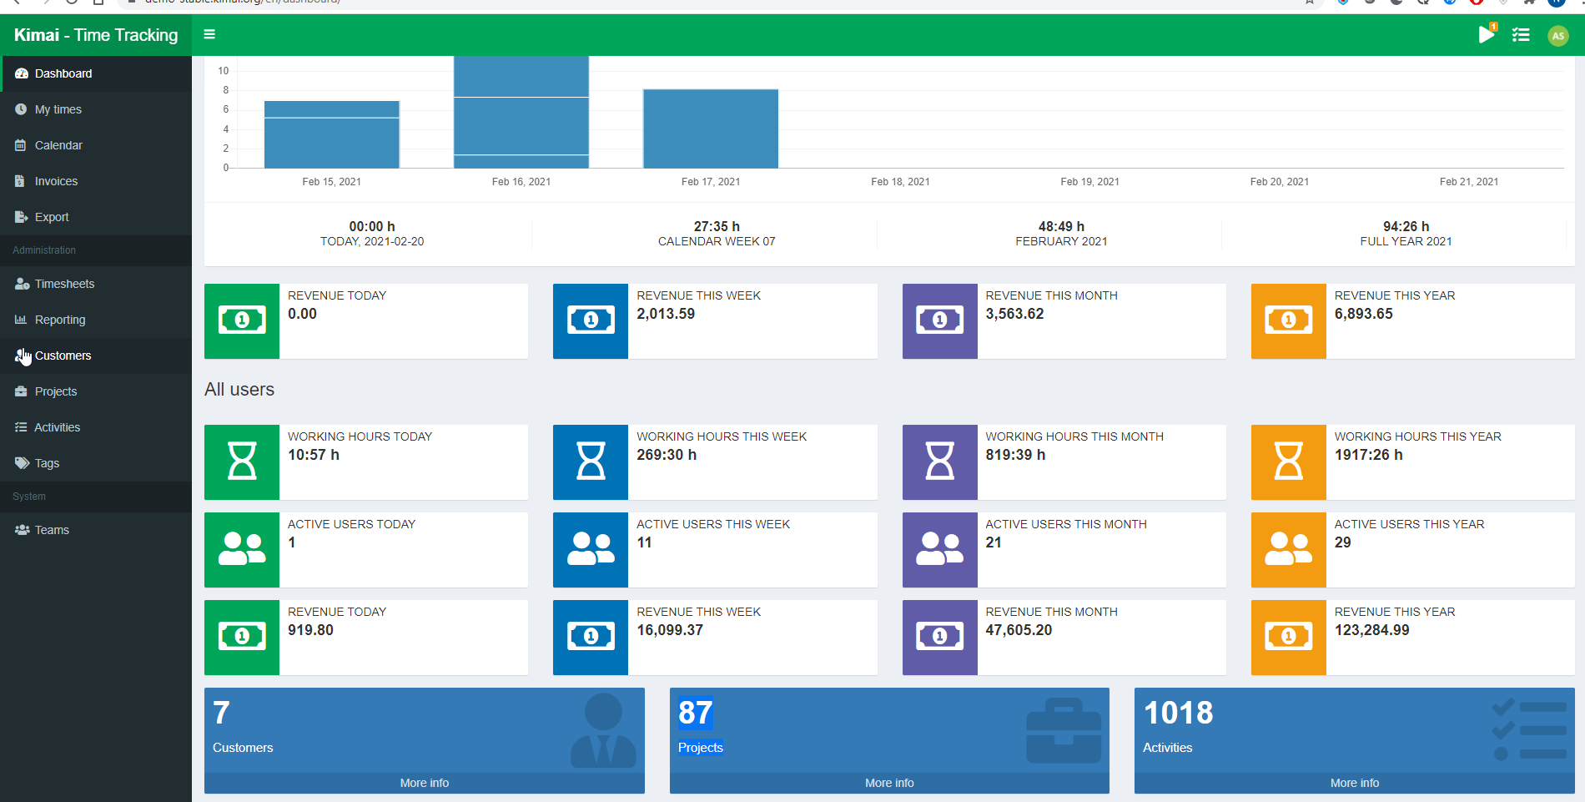
Dashboard admin:

Slide 17
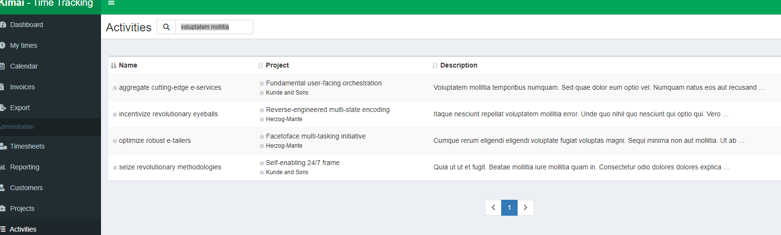
Search for name and description
not quick-search
filters allow only one sorting and no data filtering by column
no element count limit

Slide 18
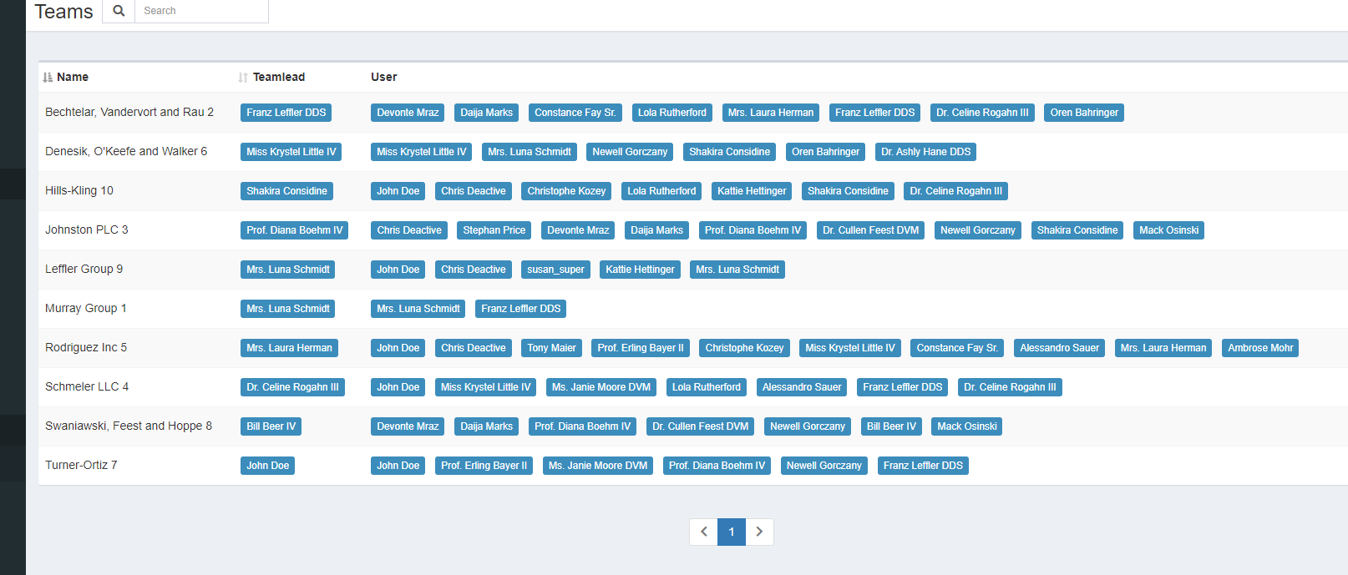
Teams
no quick search
not global search – user search is extra menu
multiple user search does an OR not an AND

